Slide 1
Applying ML to House Prices in Ames
Shameer Sukha

Slide 2
Data Science Lifecycle
1) Business understanding
2) Data mining
3) Data cleaning
4) Data exploration
5) Feature engineering
6) Predictive modelling
7) Present insights

Slide 3
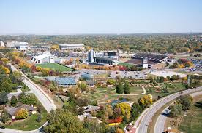
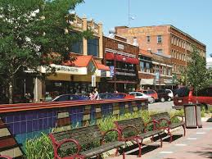

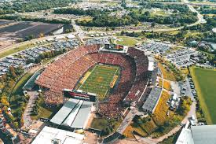


1) Business understanding
Top 100 best places to live
Iowa State University town
Academic, sports, culture
Public parks, open spaces
Good healthcare and jobs
Young population
What about real estate in Ames?
Classic case to apply supervised machine learning

Slide 4
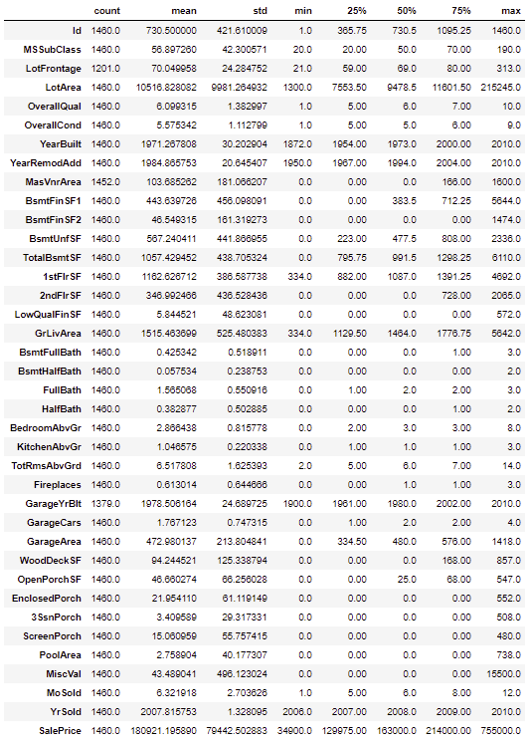
2) Data mining
No need to mine housing data
Kaggle competition
1460 datapoints
79 features
Data types
Categorical
Nominal
- Neighbourhood
- Type of material/condition
Ordinal
- Quality of house
- Quality of finish
Numerical
- Size (area sq. ft)
- No. of rooms

Slide 5
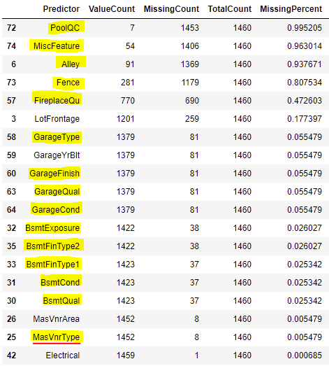
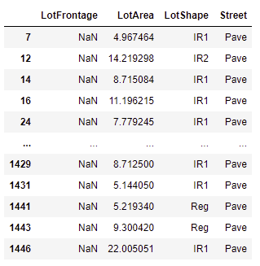
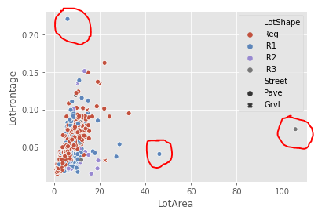

3a) Data cleaning : missing data or errors
Most missing data were Not Missing At Random (NMAR)
Missing because of lack of feature
Highlighted in yellow
Impute with ‘N’
Except MasVnrType (red underline): impute with ‘None’
MasVnrArea
NMAR since houses with MasVnrType = ‘None’ are missing
Impute with 0
Electrical:
Impute ‘Mix’ since only 1 data point missing and won’t be material
LotFrontage:
Appears to be Missing At Random (MAR)
Related to LotArea (which is complete)
Use KNN imputation with k = 35 since outliers are present
BsmtExposure:
Change ‘N’ to ‘No’ since ‘N’ and ‘No’ mean different things
GarageYrBlt:
NMAR: Impute zeros to be YearBuilt

Slide 6
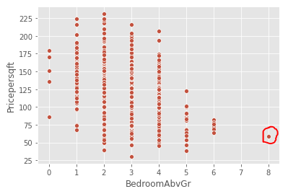
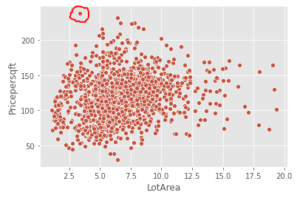
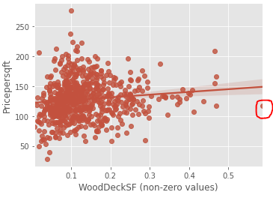
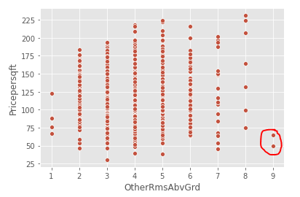
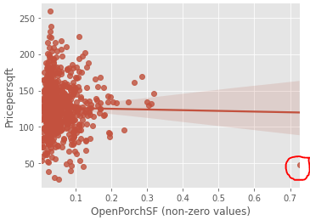
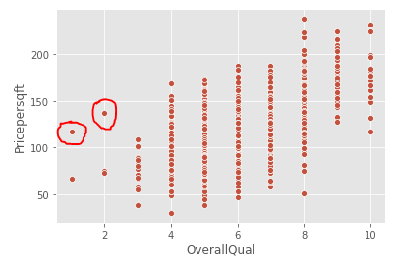
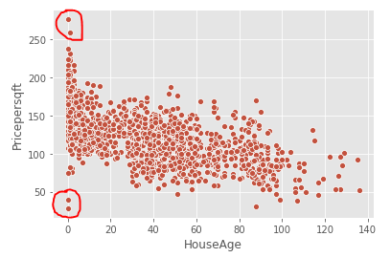
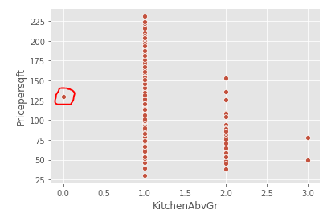
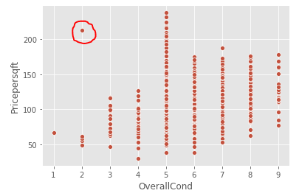
3b) Data cleaning: outliers
OpenPorchSF
Drop 1 record (Abnormal SaleCOndition) had value >70% of GrLivArea
WoodDeckSF
Drop 1 record that had value >50% of GrLivArea
MiscFeature
Drop 1 record that had tennis court
Drop 2 records that had ‘Othr’ (no explain)
Drop 2 records that had ‘Gar2’
LotArea
Drop 20 records that had lot sizes that are 20 times greater than GrLivArea
Such large lot sizes are likely special cases
HouseAge, OverallCond, OverallQual and SalePrice
Drop 4 records where house age is 0 or 1 year and SalePrice / GrLivArea is greater than 250 and less than 50
Drop 1 record where condition is 2 and SalePrice / GrLivArea > 250
Drop 2 records where quality < 3 and SalePrice / GrLivArea > 100
Drop 1 record with 8 bedrooms
Drop 1 record with 0 kitchens
Drop 2 records with 9 other rooms
Linear models (without regularization) are sensitive to outliers

Slide 7
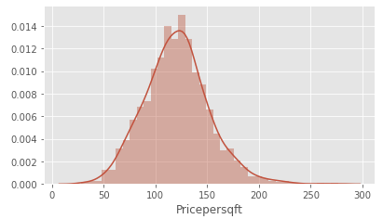
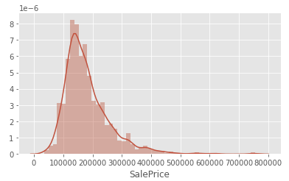
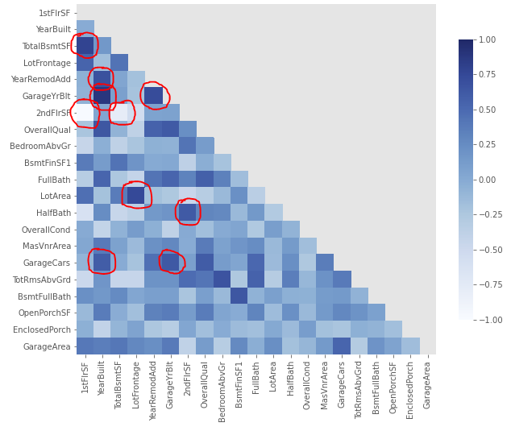
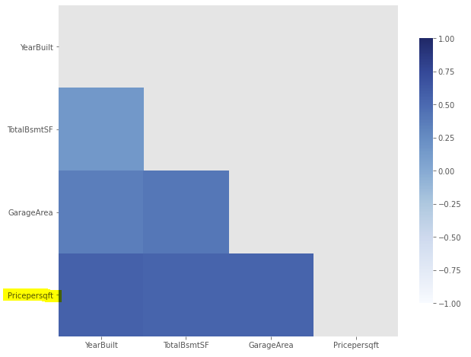
4) Data exploration
34 numerical and 45 categorical
Highly skewed distributions (>9): MiscVal, PoolArea, LotArea, 3SsnPorch, LowQualFinSF (due to many zeros)
SalePrice
Use GrLivingArea to create ‘Pricepersqft’ (which is much closer to normal distribution)
All area variables
Divide all area variables by GrLivingArea, which brings comparability and standardisation benefits
Features correlated with Pricepersqft
Surprisingly YearBuilt, TotalBsmntSF, GarageArea are demonstrating >50% correlation
Multicollinearity is going to be a problem
Top10 pairs are >90% correlated
58 pairs are greater than 70% correlated
Most correlations make sense, e.g. 1stFlrSF/2ndFlrSF, YearBuilt/GarageYrBult, TotalBsmtSF/1stFlrSF, LotFrontage/LotArea, YearRemodAdd/GarageYrBlt
Curse of dimensionality is going to be a problem

Slide 8
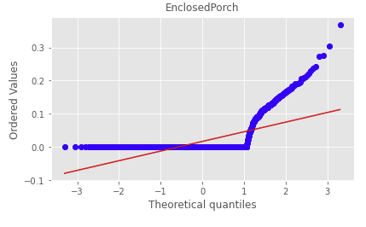
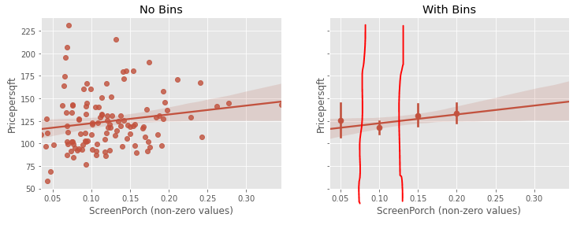
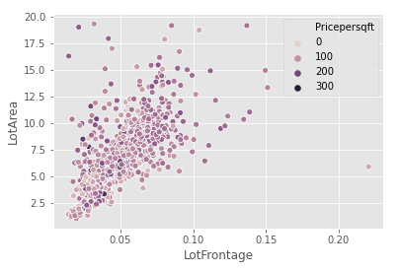
5a) Feature Engineering
Use grid search Lasso before any feature engineering to see what R2 can be obtained: 0.78
Porch-related
All qq-plots are similar, reflecting highly-skewed distributions due to imbalanced datasets (due to lack of feature)
Convert to categorical variables using bins to identify splits
Drop 3SsnPorch since too sparse
Misc. variables
After dropping tennis court etc, convert to categorical indicating if ‘Shed’ is present
Drop MiscValue
Pool-related
Too sparse, only 6 datapoints so drop PoolArea and PoolQC
Lot-related
Drop LotFrontage since related to LotArea (which is of more interest)
Make LotShape binary Regular or Irregular
Drop Street since only 3 Gravl
LowQualFinSF
Drop since sparse and info likely contained in Overall quality variable

Slide 9
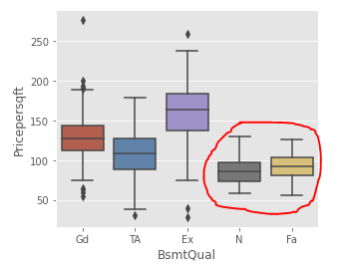
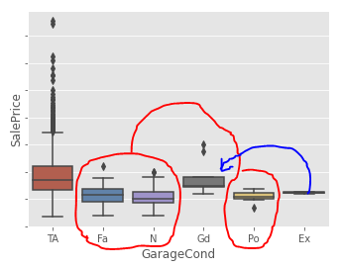
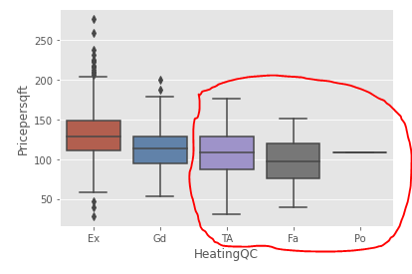
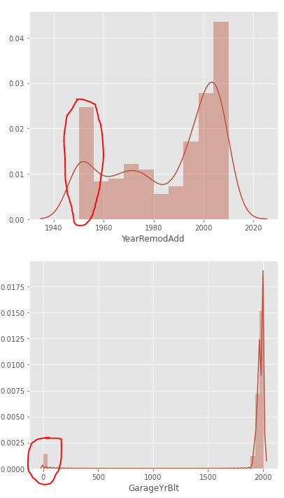
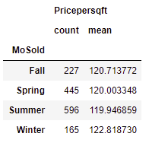
5a) Feature Engineering
Basement-related
Perfect multi-collinearity with basement area variables, drop BsmtFinSF1/2 and BsmtFinType1/2
Consolidate ‘N’ and ‘Fa’ for BsmtQual.
DropBsmtCond and BsmtExposure -- sound like important variables but what matters is size, quality and how much still unfinished
Garage-related
Drop GarageArea since info contained in more interpretable GarageCars
Consolidate GarageCond into 3 categories and GarageType into 4
Drop GarageQual since likely captured in GarageCond and OverallQual
Living area-related
Drop 1stFlrSF since info contained in GrLivArea
Create ‘OtherRmsAbvGrd’ = TotRmsAbvGrd – BedroomAbvGr and drop TotRmsAbvGrd
Fireplaces and Environment-related
Drop Heating, CentralAir and Electrical since too sparse after one-hot encoding
Consolidate HeatingQC and FireplaceQu into 3 categories
Calc age out of Year variables
Drop GarageYrBlt since YearRemodAdd captures this plus more
Create HouseAge = YrSold - YearBuilt
Create RemodAge = YrSold – YearRemodAdd
Sale-related
Consolidate SaleType and SaleCondition into 3 and 4 categories
Convert MoSold into Season variable for the 4 seasons

Slide 10
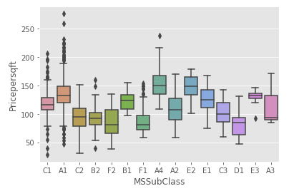
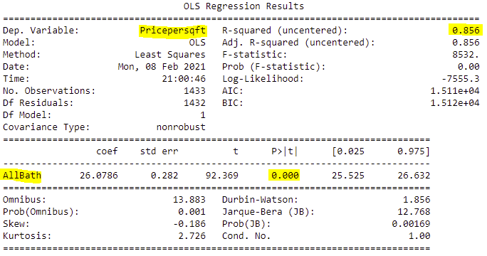
5a) Feature Engineering
Exterior-related
Drop Fence, Foundation, Exterior2nd, Exterior1st, RoofMatl, RoofStyle since not much explanatory power
Consolidate Functional, ExterCond and ExterQual into 4, 3 and 3 categories respectively.
Drop MasVnrArea since type has more explanatory power
Land-related
Drop Landslope, Utilities and LotShape since no explanatory power
Drop Condition2, Alley, LandContour and LotConfig since sparse or low explanatory power likely only creating multicollinearity
Consolidate Condition1 railroads and positive features into single category
Bathroom-related
Create AllBath = 2*FullBath + 1.5*Halfbath + 1*BsmtFullBath + 0.5*BsmtHalfBath
Drop all bath features retaining single one
Manually reduced 79 features to 37.
Use grid search Lasso again to check impact: R2 = 0.7967
Have reduced multicollinearity and have slightly gained some explanatory power.

Slide 11
5a) Feature Engineering
Exterior-related
Drop Fence, Foundation, Exterior2nd, Exterior1st, RoofMatl, RoofStyle since not much explanatory power
Consolidate Functional, ExterCond and ExterQual into 4, 3 and 3 categories respectively.
Drop MasVnrArea since type has more explanatory power
Land-related
Drop Landslope, Utilities and LotShape since no explanatory power
Drop Condition2, Alley, LandContour and LotConfig since sparse or low explanatory power likely only creating multicollinearity
Consolidate Condition1 railroads and positive features into single category
Bathroom-related
Create AllBath = 2*FullBath + 1.5*Halfbath + 1*BsmtFullBath + 0.5*BsmtHalfBath
Drop all bath features retaining single one
Reduced 79 features to 37 manually.
Use grid search Lasso again to check impact: R2 = 0.7967
Have reduced multicollinearity and have slightly gained some explanatory power.

Slide 12
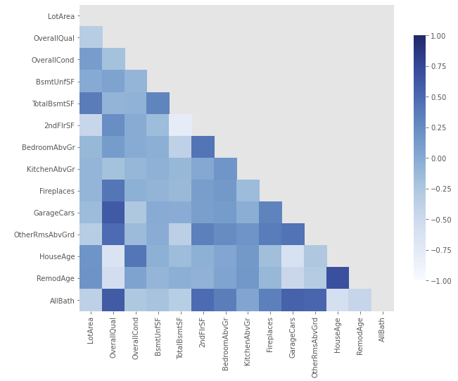
5a) Feature Engineering
Exterior-related
Drop Fence, Foundation, Exterior2nd, Exterior1st, RoofMatl, RoofStyle since not much explanatory power
Consolidate Functional, ExterCond and ExterQual into 4, 3 and 3 categories respectively.
Drop MasVnrArea since type has more explanatory power
Land-related
Drop Landslope, Utilities and LotShape since no explanatory power
Drop Condition2, Alley, LandContour and LotConfig since sparse or low explanatory power likely only creating multicollinearity
Consolidate Condition1 railroads and positive features into single category
Bathroom-related
Create AllBath = 2*FullBath + 1.5*Halfbath + 1*BsmtFullBath + 0.5*BsmtHalfBath
Drop all bath features retaining single one
Reduced 79 features to 37 manually.
Use grid search Lasso again to check impact: R2 = 0.7967
Have reduced multicollinearity and have slightly gained some explanatory power.

Slide 13
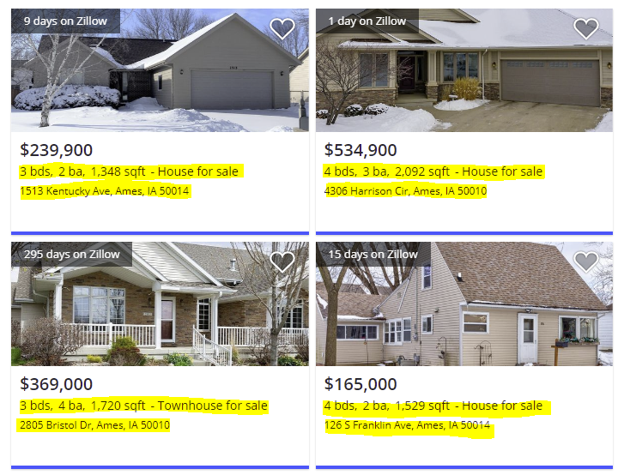
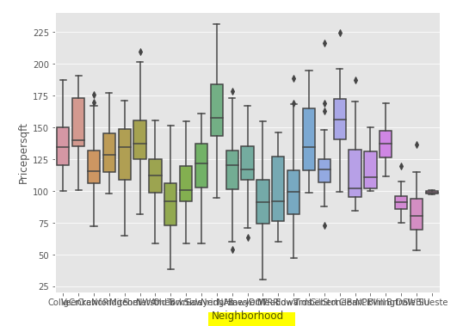
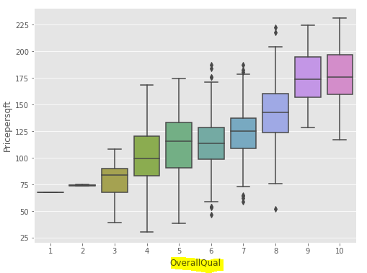
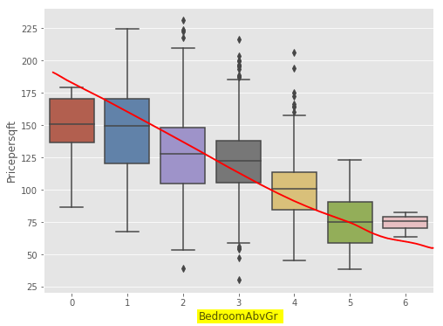
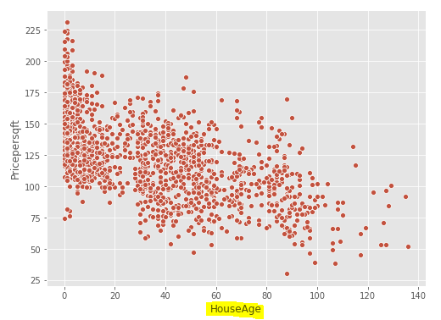
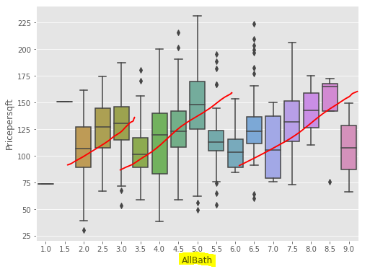
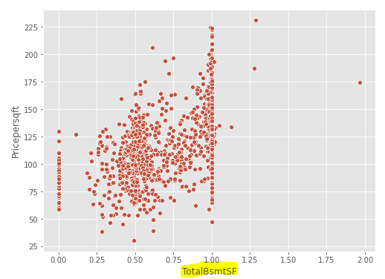
5b) Feature Selection
What do I think are important features?
Any Realtor/ Real-estate site / common-sense says:
Neighbourhood
House Type
# Bedrooms
# Bathrooms
Size of house
That is for predicting SalePrice
I am modelling [Sale Price per sq. ft] !
If building 3 or 4 bedroom house, it can still make sense for cost to be $120 per sq. ft
Average/Median cost is $120 with min $30 and max $230 (std dev 30)
So what would really differentiate Price per sq. ft?
Definitely Neighbourhood
House age
Overall quality
Size of basement?
Bedroom shows law of diminishing returns!
See-saw pattern for Bathroom makes sense because it of basement bathroom costs that adds to cost per sq. ft.
Notes:
Subjective feature selection first

Slide 14
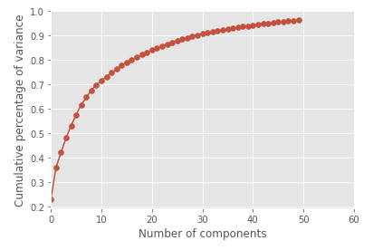
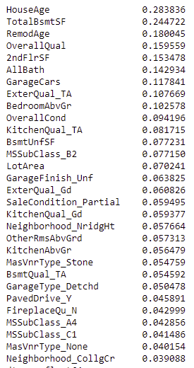
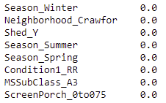
5b) Feature Selection
Check PCA in case any obvious inferences about features
Use One-Hot encoding for categorical features with drop_first=True
Scale numerical variables by subtracting mean and dividing by std. dev
First 10 components explain ~70%, first 20 ~83% and first 30 about 90% of the variance amongst all features
Nothing meaningful since no obvious ‘elbows’ on scree-type plot
Check if Mutual information can provide insight
Mutual information is an information entropy-based test, which generalizes correlation in a non-linear manner. Information entropy is useful for tree-based models.
It apeears that HouseAge, TotalBsmtSF, RemodAge, OverallQual, 2ndFlrSF, AllBath and GarageCars are top features, which is intutitvely correct
It appears Season doesn’t really have an effect
Mutual information doesn’t work well for small sample sizes (<1000) and/or high dimensionality so don’t place too much weight yet
Future exploration: Stability selection using Lasso learner (Meinshausen & Bühlmann 2010)
Ready to apply machine-learning models!
✓
✗
?
Notes:
Objective feature selection

Slide 15
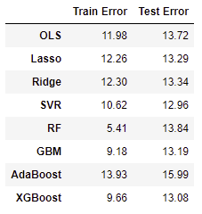
6) Predictive Modelling
Train-Test split
Hold-out 30%
Use 70% for training
Hyper-parameter tuning
Grid-search
Stratified K-fold cross-validation with K=10
Root Mean Square Error (RMSE)
Gives error in units of Pricepersqft ($)
Feature Importance
Understand which features are important
Standard Scaling
Scale features by subtracting mean and dividing by std. dev
Supervised Learning
Regression
Regularization
Instance-based
Ensemble
Ordinary Least Squares
Ridge
Lasso
Support Vector Regression
Random Forest
Gradient Boosting Machine
AdaBoost
XGBoost
Stochastic Gradient Boost

Slide 16
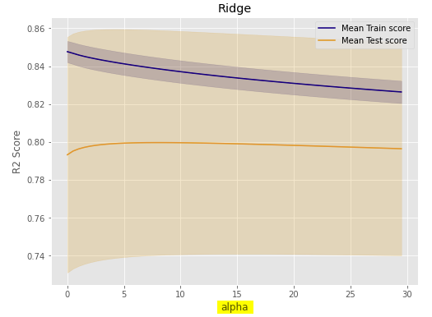
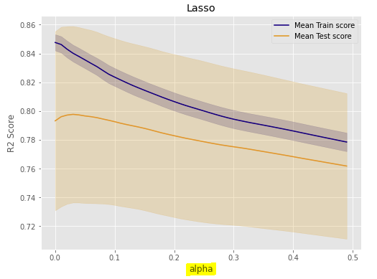
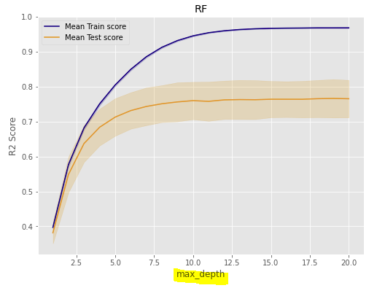
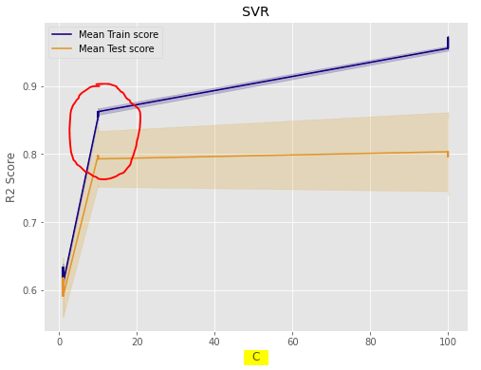
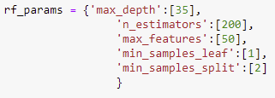

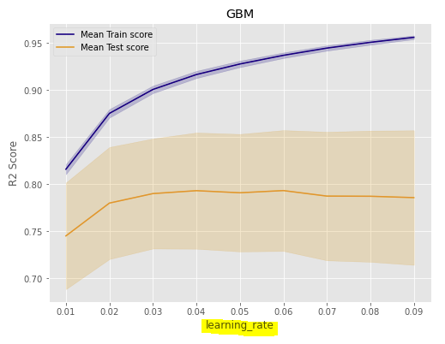
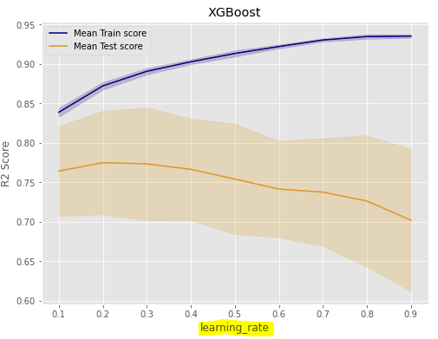
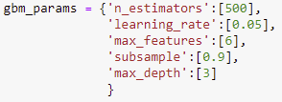

6) Predictive Modelling
Model Bias
Model Variance
Gridsearch with 10-fold Stratified cross-validation helps to prevent overfitting
Hyperparameter tuning:
parameters that directly control model complexity by introducing regularization/cost term (alpha, C, gamma)
Injecting randomness to make training robust to noise (subsample, colsample_bytree)
Still work to be done to reduce overfitting, although there must exist some ‘irreducible error’ in this problem
$13 per sq. ft is not bad considering that 5% commission/legal cost could explain about $5-7 and other factors influencing price.

Slide 17
7) Present insights
Which model should I select?
Typically Linear regression exhibits high-bias and low-variance but don’t require computation time
Typically Tree-based and SVM models exhibits low bias and high variance and can be computationally expensive
The domain of this house prices problem statement makes it ripe to apply linear models…
However, even after a huge effort in feature engineering, linear models don’t make intuitive sense (even after regularization)
The AdaBoost model could easily be dismissed based on train/test scores!
However, the top10 important features make most sense to me in context of this problem
I understand why Boosting techniques have become popular - Ensembling weak learners into a strong learner makes sense (AdaBoost puts more weight on difficult instances)
Future work:
Spend more time training AdaBoost
Develop waterfall chart showing make-up of average sale price per sq. ft
Develop interactive dashboard to understand make-up of sale price per sq. ft (will help with remodelling/renovations and comparison to builder costs)
OLS | Lasso | Ridge | RF
SaleType | Neighborhood | HouseAge | Neighborhood
SaleCondition | SaleType | TotalBsmtSF | MSSubClass
GarageFinish | HouseAge | Functional | Condition1
Functional | Functional | Neighborhood | PavedDrive
Neighborhood | TotalBsmtSF | BsmtQual | GarageType
MasVnrType | GarageFinish | OverallQual | Shed
GaragCondition | ExterQual | SaleType | KitchenQual
MSSubClass | OpenPorch | GarageFinish | OpenPorch
KitchenQual | MSSubClass | ExterQual | ScreenPorch
HouseAge | BsmtQual | OverallCond | GarageFinish
GBM | AdaBoost | XGBoost
TotalBsmtSF | HouseAge | ExterQual
OverallQual | TotalBsmtSF | KitchenAbvGr
HouseAge | LotArea | TotalBsmtSF
2ndFlrSF | OverallQual | 2ndFlrSF
OverallCond | BsmtUnfSF | GarageCond
LotArea | AllBath | HouseAge
RemodAge | OverallCond | OverallQual
KitchenQual | Neighborhood | OverallCond
ExterQual | RemodAge | BedroomAbvGr
BedroomAbvGr | ExterQual | FireplaceQu

